Slide 1
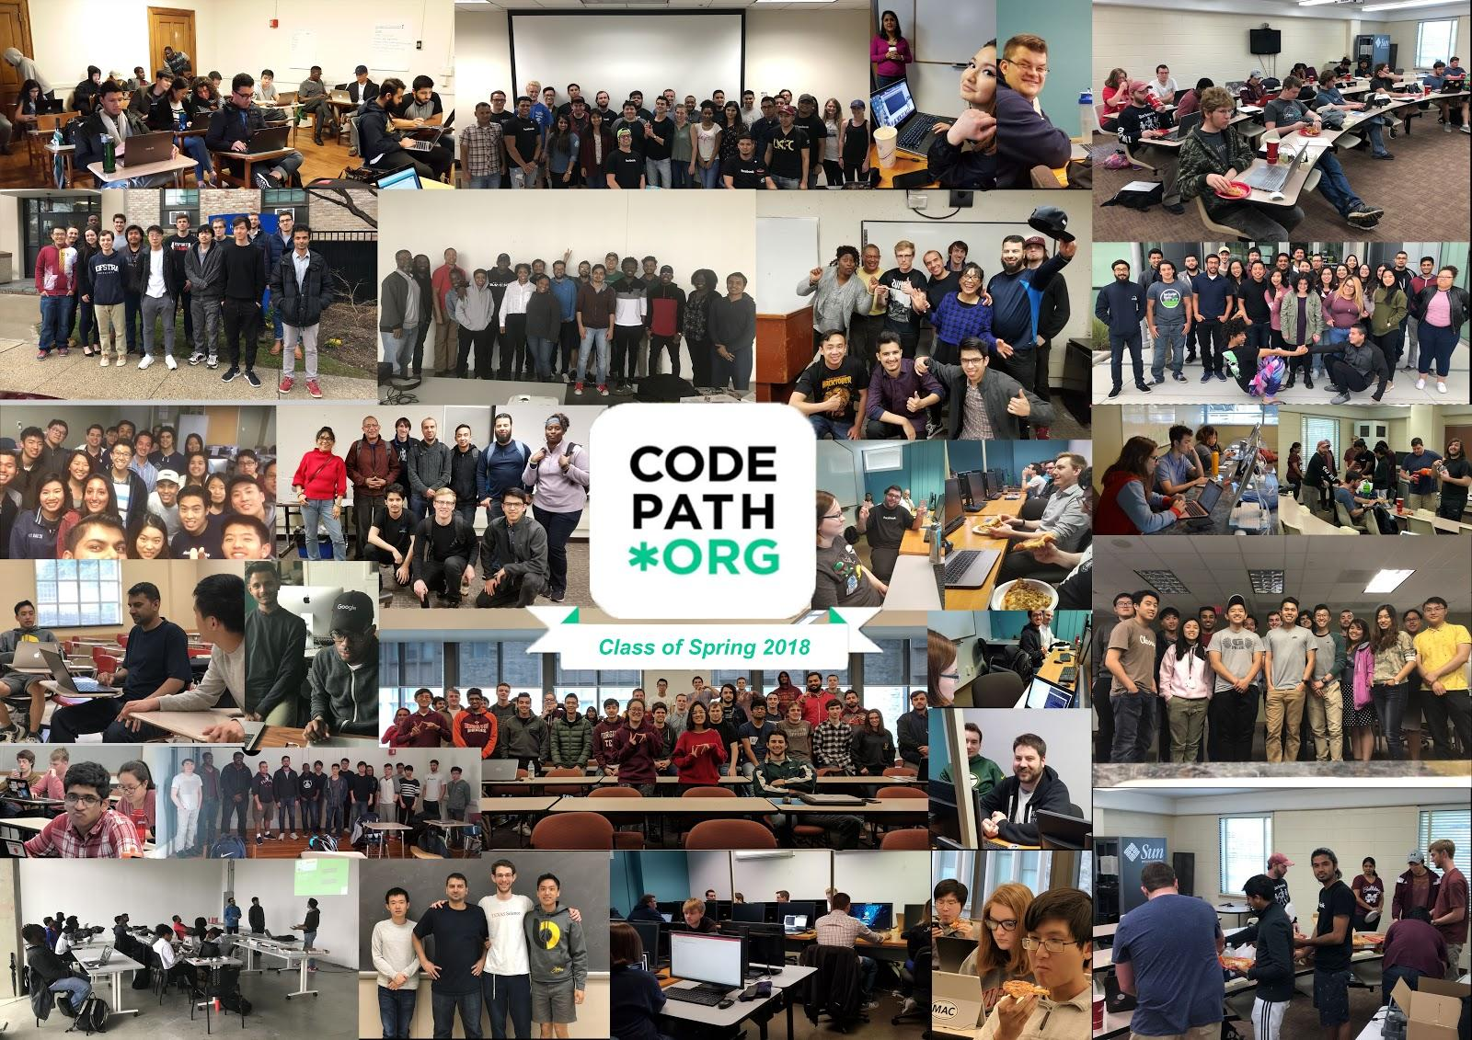

Learn. Build. Teach. Change the World.

Slide 2

Unit 0 - Orientation
Everything you need to know to get started!

Slide 3
😎 Meet Your Tech Fellows

Slide 4
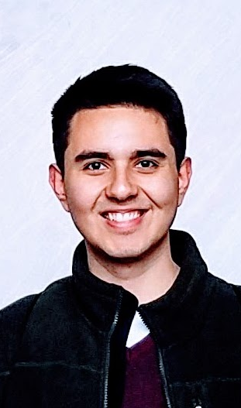
HI_MY_NAME_IS Guillermo Sanchez
Got a scholarship from MakeSchool
Play instruments (mainly Guitar)
Code for fun
Tacos are best in Mexico
Notes:
TECH FELLOW NOTE: Fill out this slide with your picture and info. Feel free to be creative with your pic and info. The goal is to help the class get to know you!

Slide 5

HI_MY_NAME_IS Brandon Teran
Coder
Likes Hackathons
Pushed an app to App Store
Likes to work out
Notes:
TECH FELLOW NOTE: Fill out this slide with your picture and info. Feel free to be creative with your pic and info. The goal is to help the class get to know you!

Slide 6
A Word From CodePath

Slide 7
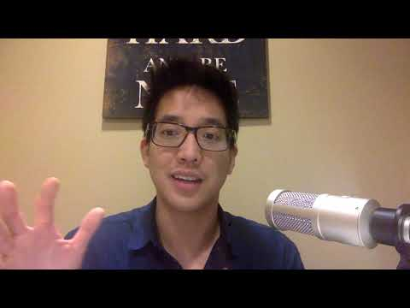
Notes:
Codepath Alumni services: guaranteed interviews as long as you complete the course and coding assesment

Slide 8
⌛ Course Timeline
Your mobile engineering journey awaits!

Slide 9
Course Timeline - Semester Long
15 Weeks
1
2
3
4
5
6
7
8
9
10
11
12
13
14
15
Notes:
This is a 15 week, semester long course
TF NOTE: If your semester is longer or shorter than 15 weeks, the course will compress or extend to fit your semester duration.

Slide 10
Course Timeline - Units
15 Units (0-14)
0
1
2
3
4
5
6
7
8
9
10
11
12
13
14
0 … because we’re engineers 😎
Notes:
The course also has 15 Units, 1 unit per week.
NOTE: We actually start (today) in Unit 0...because we’re engineers.

Slide 11
Course Timeline - Today
Orientation Unit 0
0
1
2
3
4
5
6
7
8
9
10
11
12
13
14
Notes:
Here we are today for Orientation in Unit 0

Slide 12
Course Timeline - App Assignments & Group Project
App Assignments Units 1-6
0
1
2
3
4
5
6
7
8
9
10
11
12
13
14
Group Project Units 7-14
Notes:
The rest of the course is split up into two halves, app assignments (Units 1-6) and group project (Units 7-14)

Slide 13
Course Timeline - 1st Half, App Assignments
App 2
Unit 3-4
0
1
2
3
4
5
6
7
8
9
10
11
12
13
14
App 1
Unit 1-2
App 3
Unit 5-6
Notes:
The 1st half is focused on developing your mobile engineering skills through building a series of apps, following along to videos and written guides.
Each app is split into 2 parts across 2 units (2 weeks).
Each week you’ll submit a completed portion of your current project.
There will also be Collaborative Coding Labs, Mini Lectures and demos to reinforce learning.

Slide 14
Course Timeline - 2nd Half, Group Project
App Building
Units 10-13
0
1
2
3
4
5
6
7
8
9
10
11
12
13
14
App Design
Units 7-9
Demo Day
Notes:
In the 2nd half, you’ll apply your engineering skills by designing, and building an original app from scratch with a small team.
In the final week, you’ll present your app at a Demo Day event.

Slide 15
📱 App Assignment Projects
Build your skills by building apps!
Notes:
Let’s take a look at the 3 apps you’ll be building in the first half of the course.

Slide 16
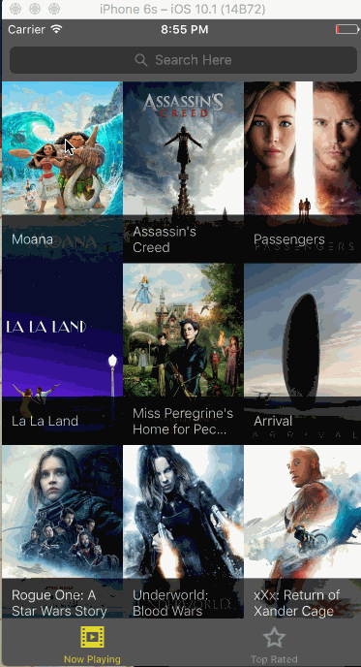
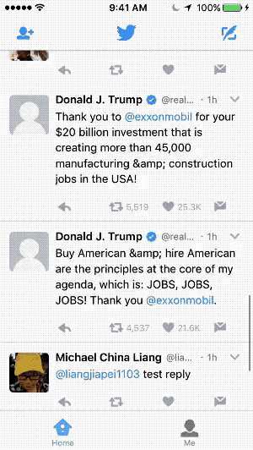
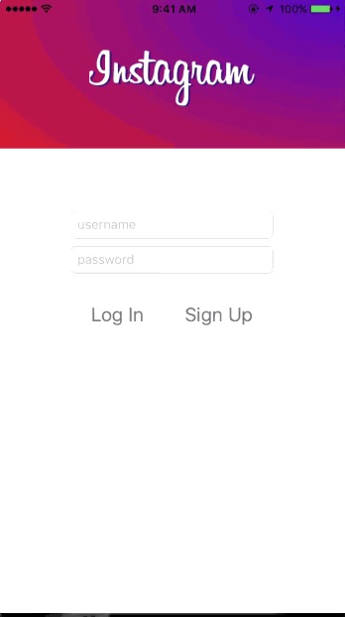
ASS IGNMENTS
Flix
Twitter
Instagram
App 1
App 2
App 3
Notes:
As mentioned earlier, there are 3 main apps you’ll be building during the 1st half of the class.
Each app is split up into 2 parts across 2 weeks.
Each week you’ll submit a completed portion of the current app you’re working on.
To build the basics of each app, you’ll follow along with videos created by professional engineers who have themselves been a part of CodePath professional courses in the past.
Those who want to take their skills to the next level can try their hand at completing bonus features (Check out the pixel perfect Twitter and Instagram apps above, those are actually student made apps!) ---
First up is Flix, an app that fetches info about movies and allows you to browse and get details, similar to Flixtre or Rotten Tomatoes
The second app is a Twitter client that allows users to login to their twitter accounts to browse and post tweets.
The 3rd app is an Instagram clone where you’ll setup your own custom web backend to store and retrieve your posts.

Slide 17
📱 Group Project App
Apply your skills to design and build an original app from scratch in a small team.

Slide 18
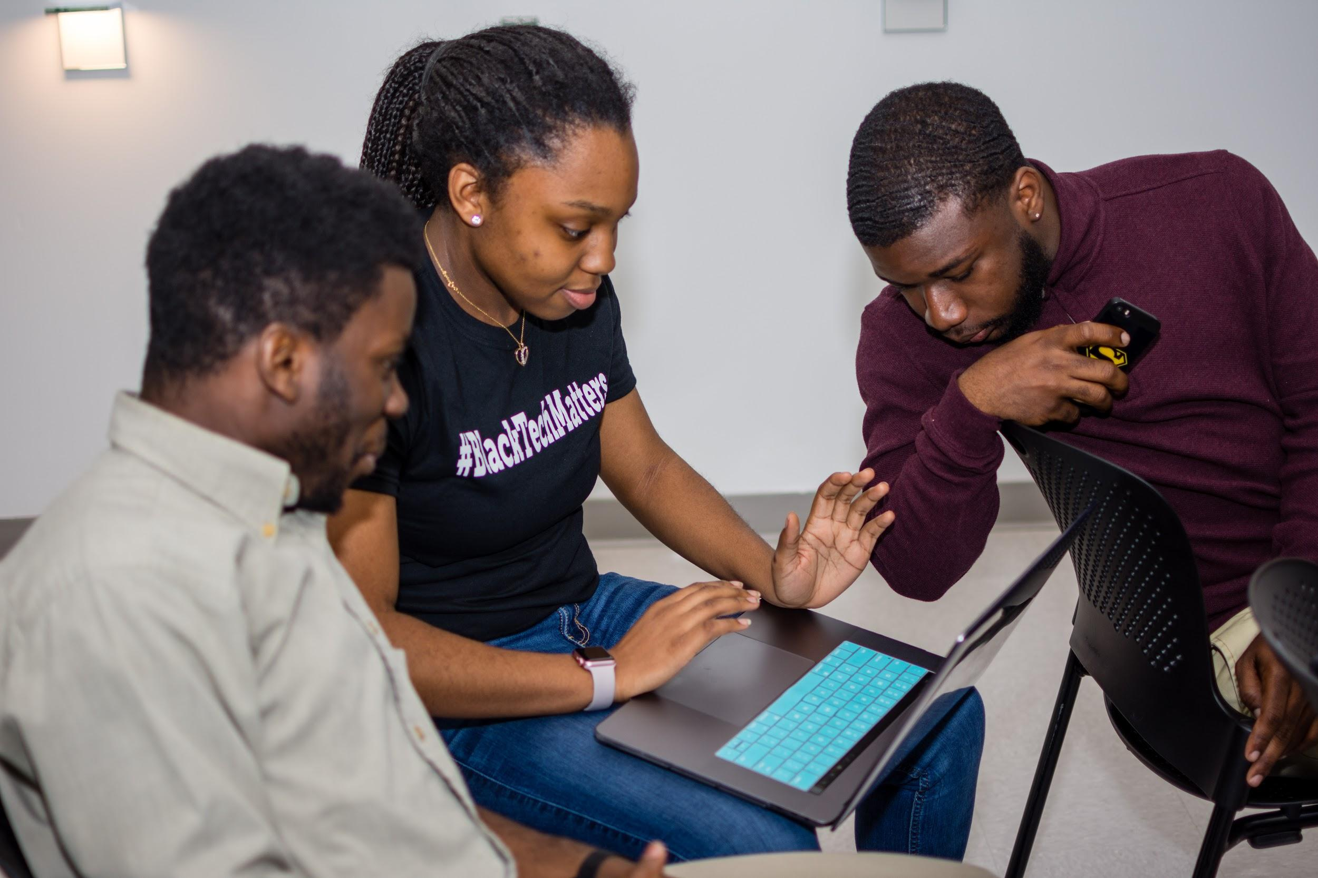
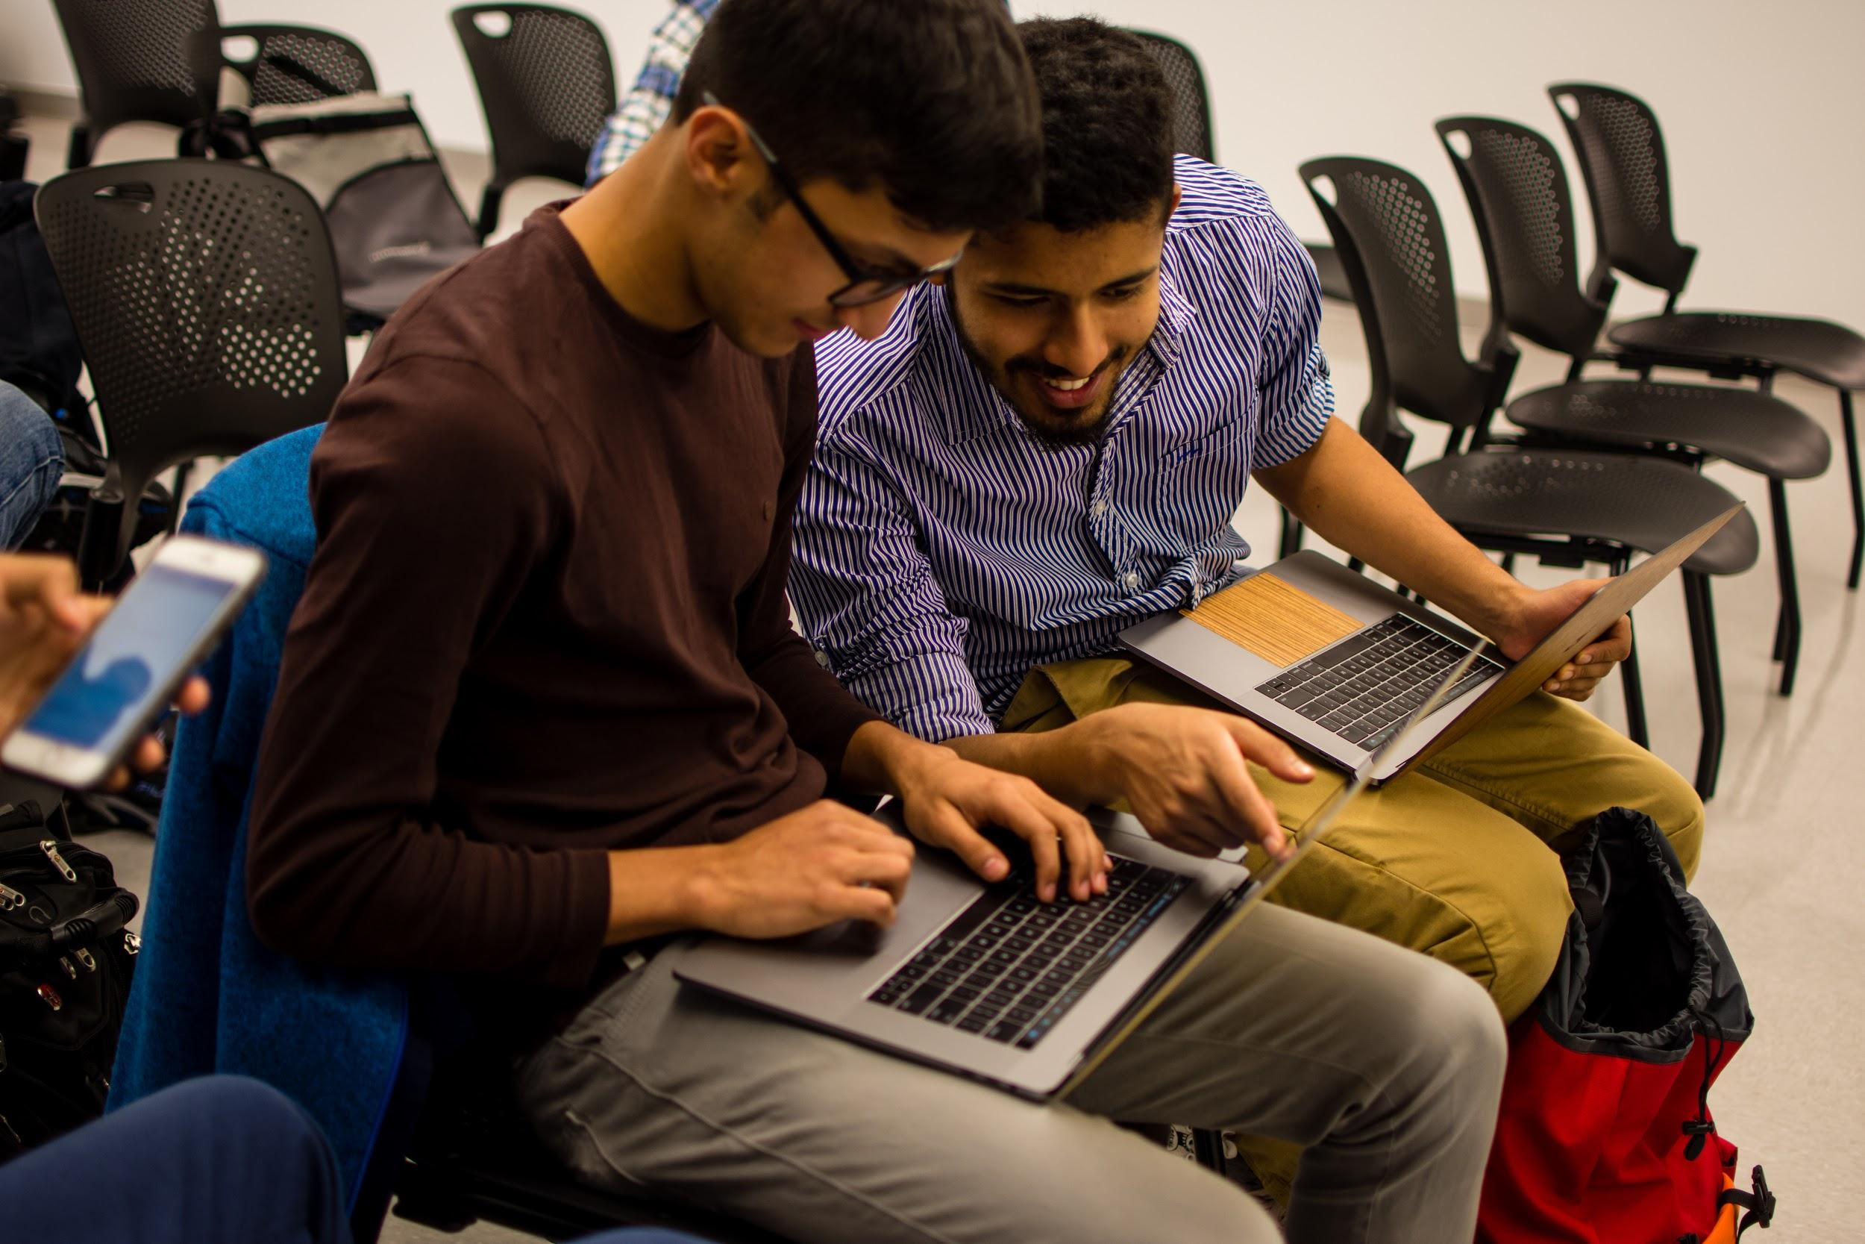
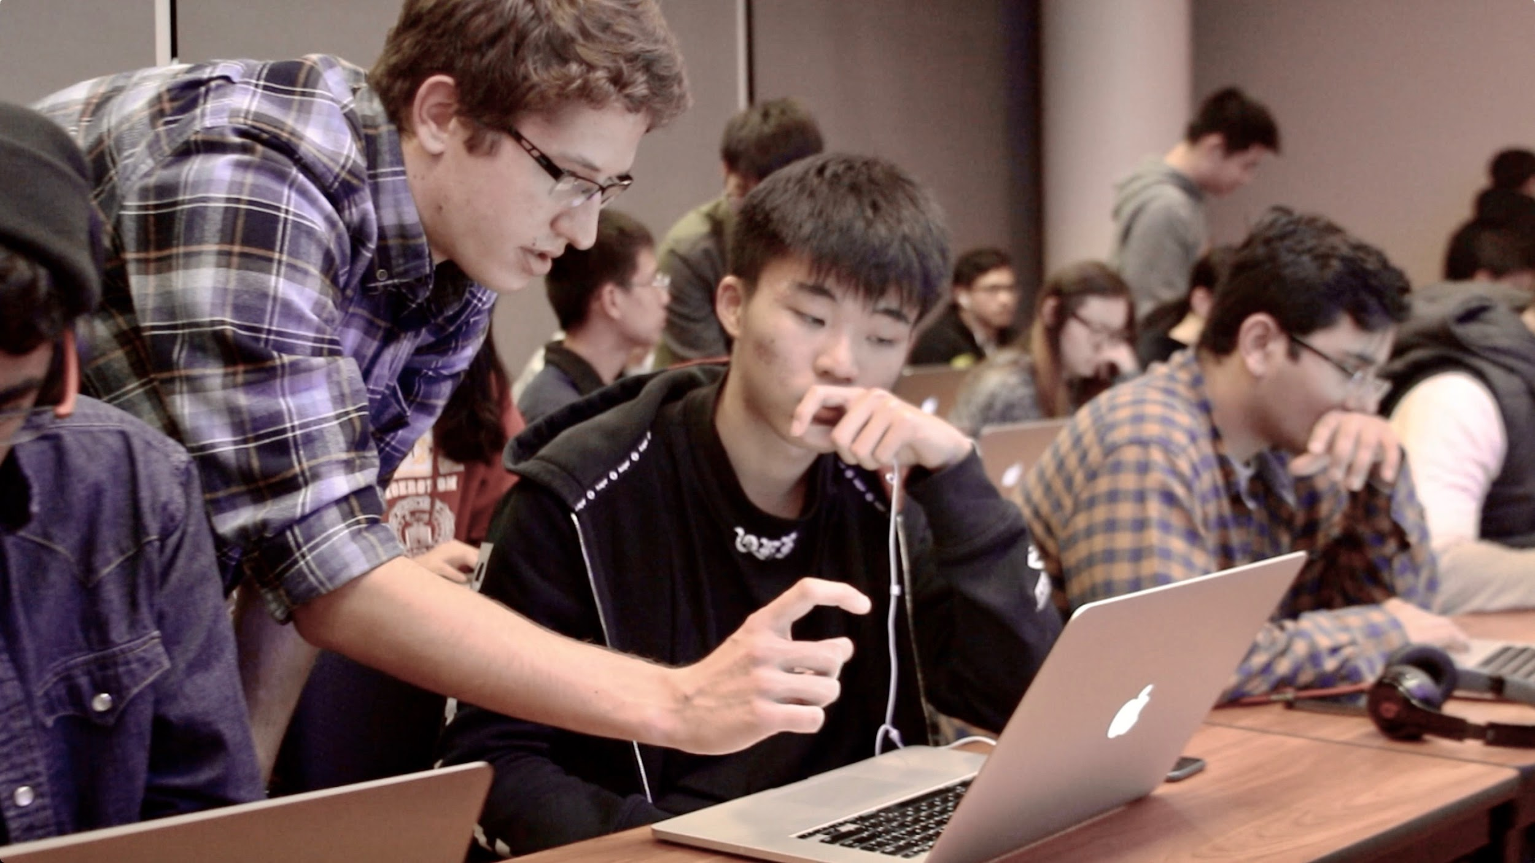
GROUP
PROJECT
Notes:
In the 2nd half of the class, you’ll be placed into small teams of 3-4.
You’ll spend a few weeks designing your app, creating wireframes and prototypes.
Then you’ll have the rest of the class to build your app with your team in preperation for Demo Day.

Slide 19
🙌 Demo Day
Present & pitch your group project app!

Slide 20
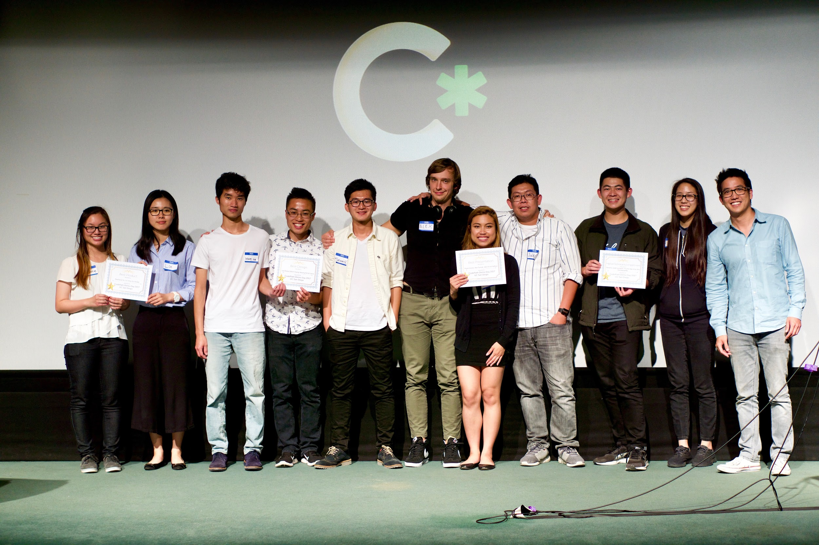
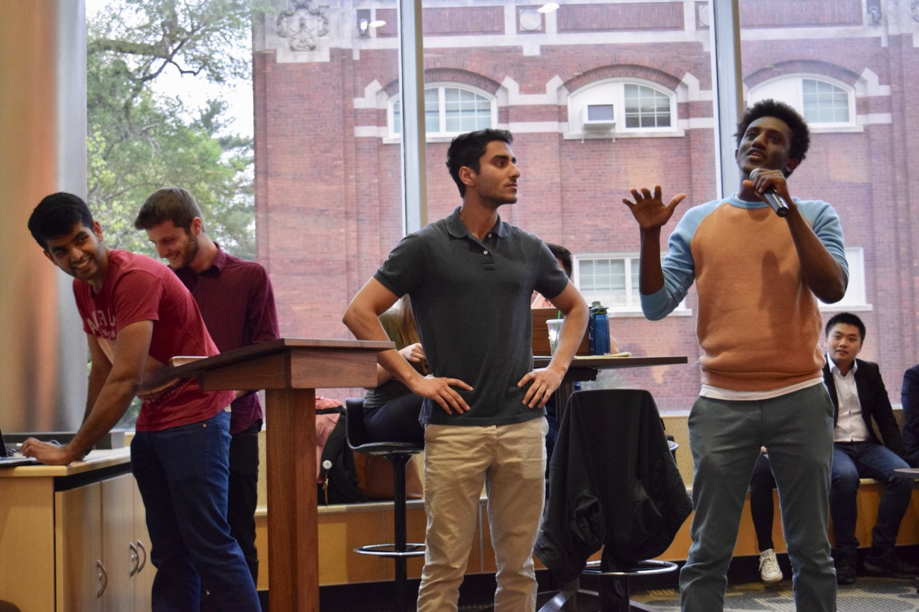
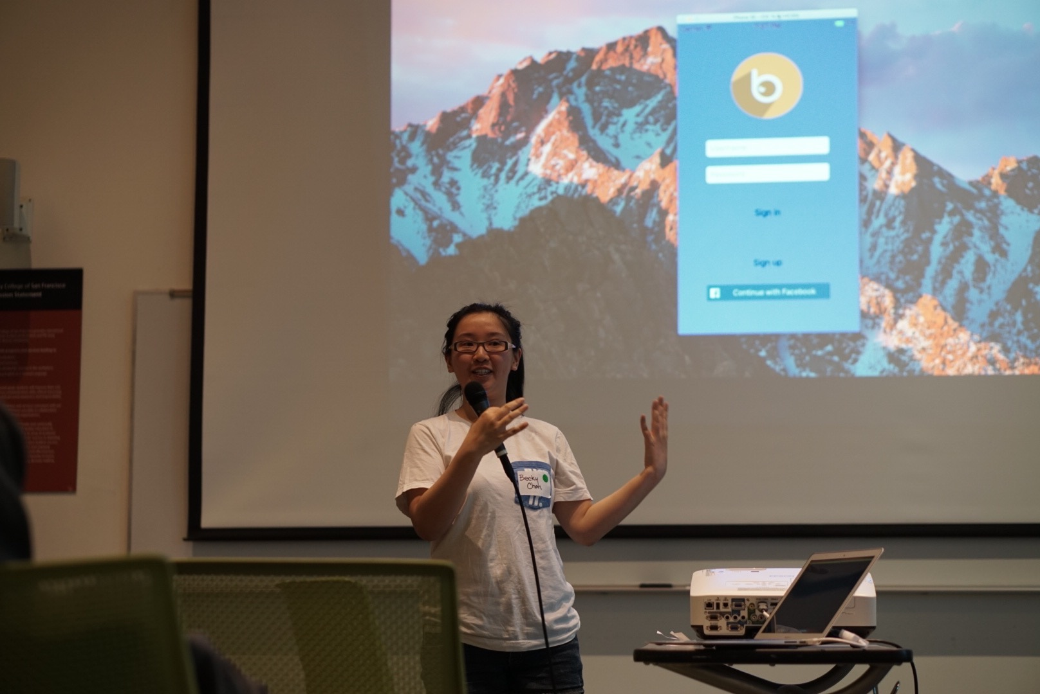
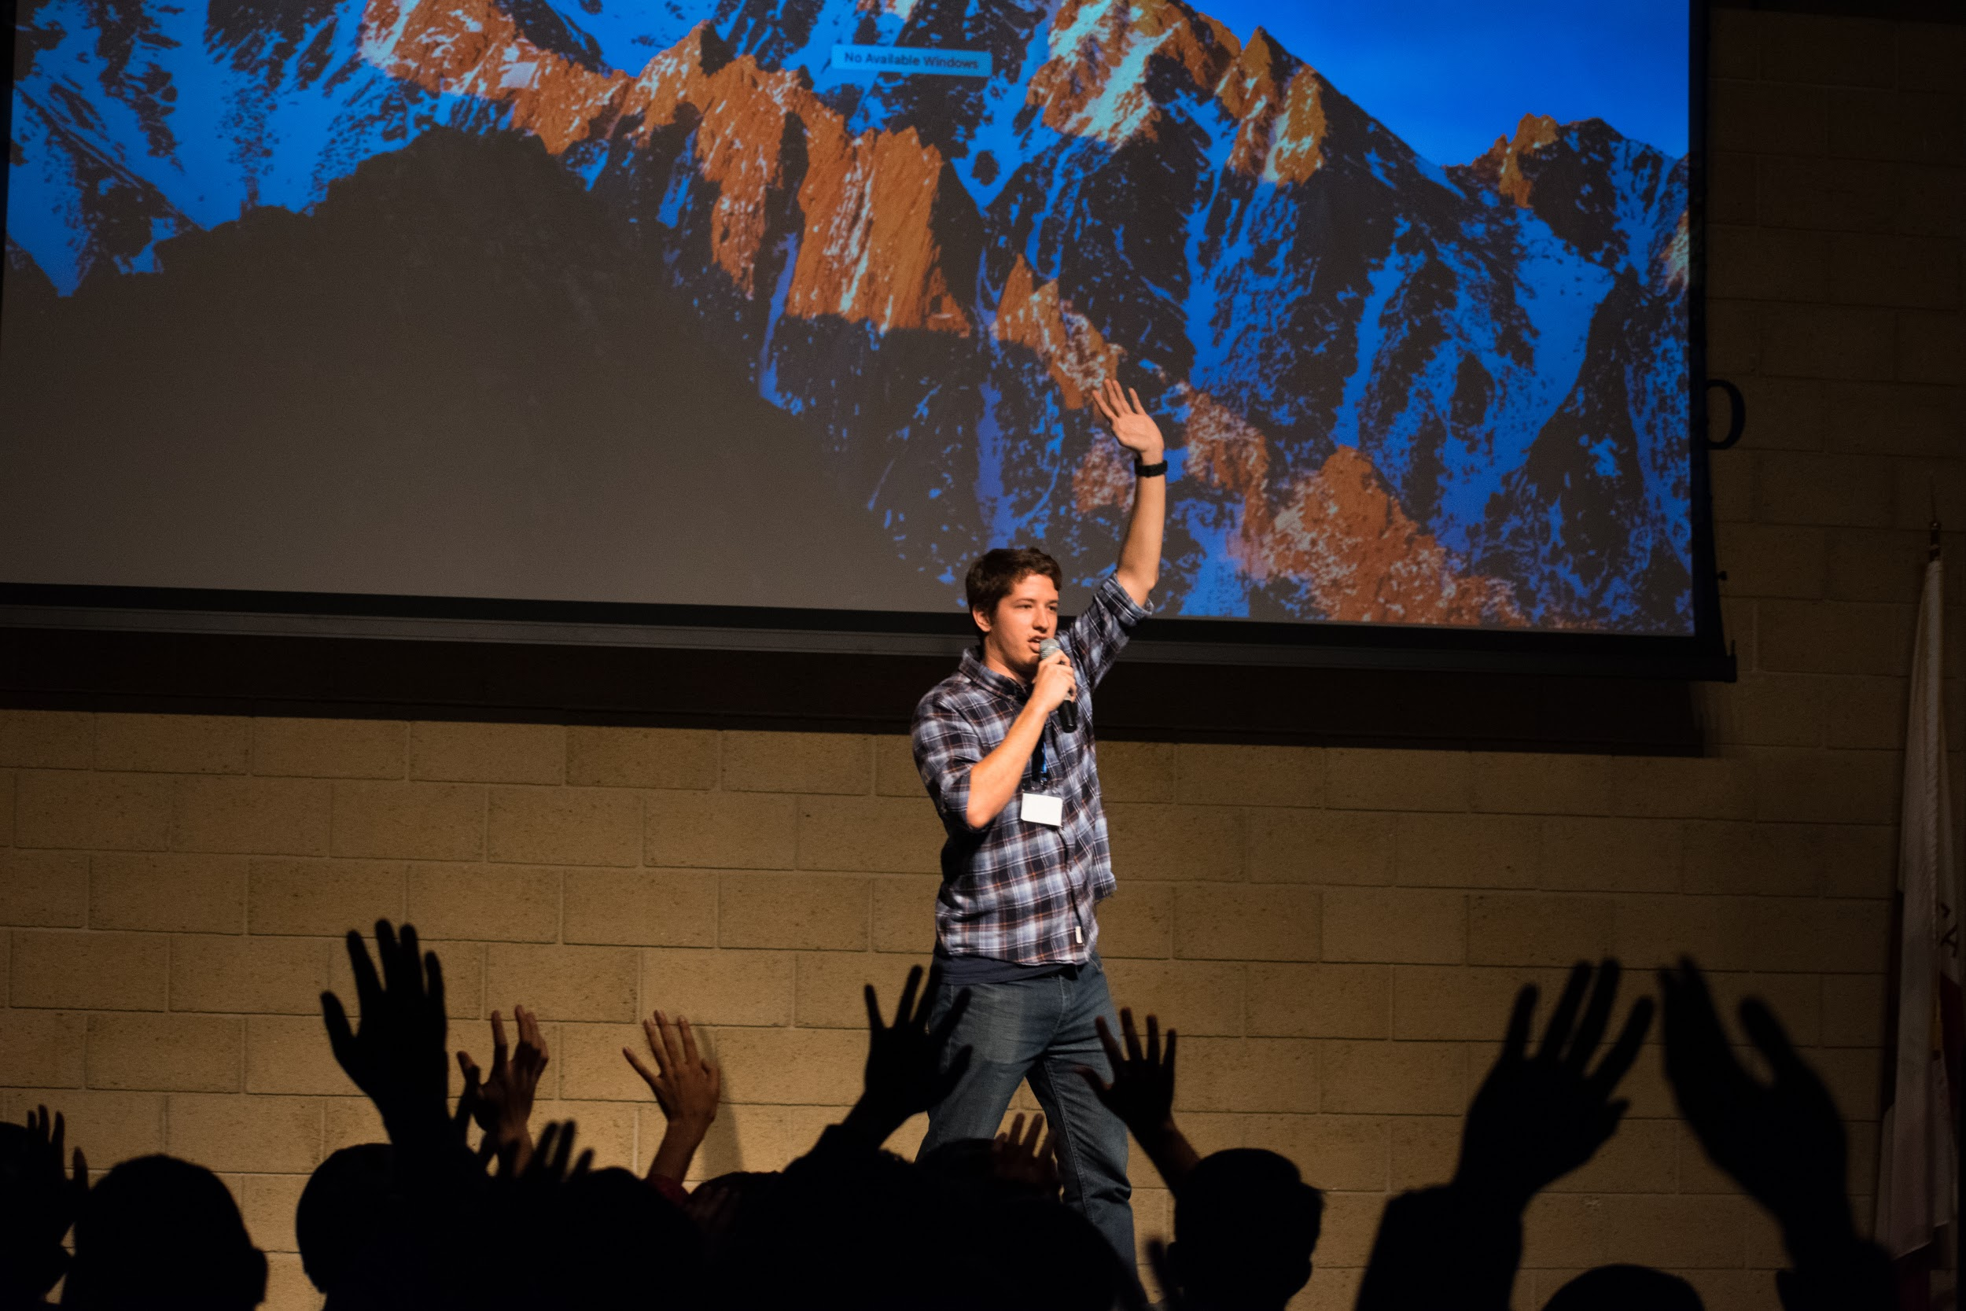
DEMO
DAY
Notes:
The class culminates in s Demo Day event where all teams will present and pitch their apps
Their is a wide variety of Demo Day formats, everything from small in-class presentations to large auditorium events with food, judges and prizes.
What kind of Demo Day would you like to have?

Slide 21
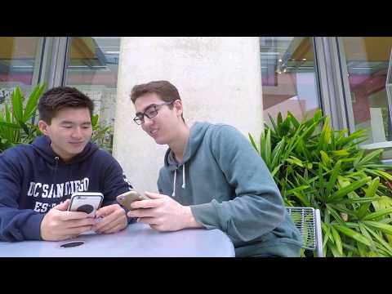
Notes:
Check out this app pitch video from Locus, a group project app created by a UC San Diego Team during our Spring 2017 Cohort.

Slide 22
💻 Course Portal
Your go-to place for everything in this course. courses.codepath.com

Slide 23
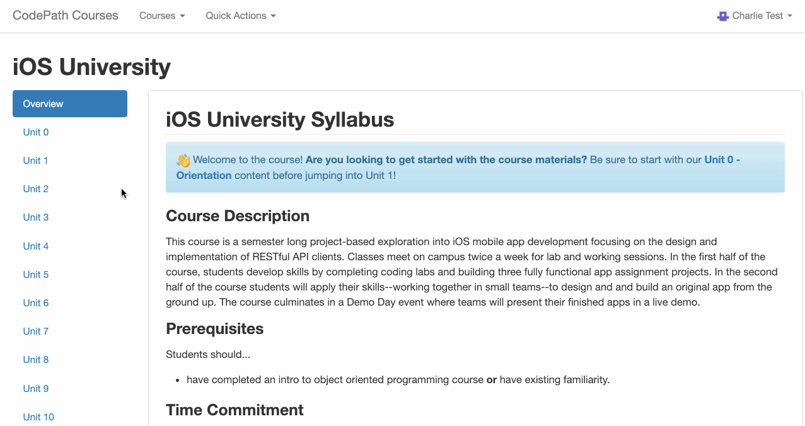
COURSE PORTAL
Notes:
The CodePath Course Portal is where you go for anything related to the course.
This is where you’ll…
See what’s going on for the week
Access lecture and demo videos
Work on and submit your weekly app and group project milestones
Collaborate in Coding Labs
Access help forums

Slide 24
✋ Getting Help
You’re not alone! Leverage the entire CodePath community when you get stuck.

Slide 25
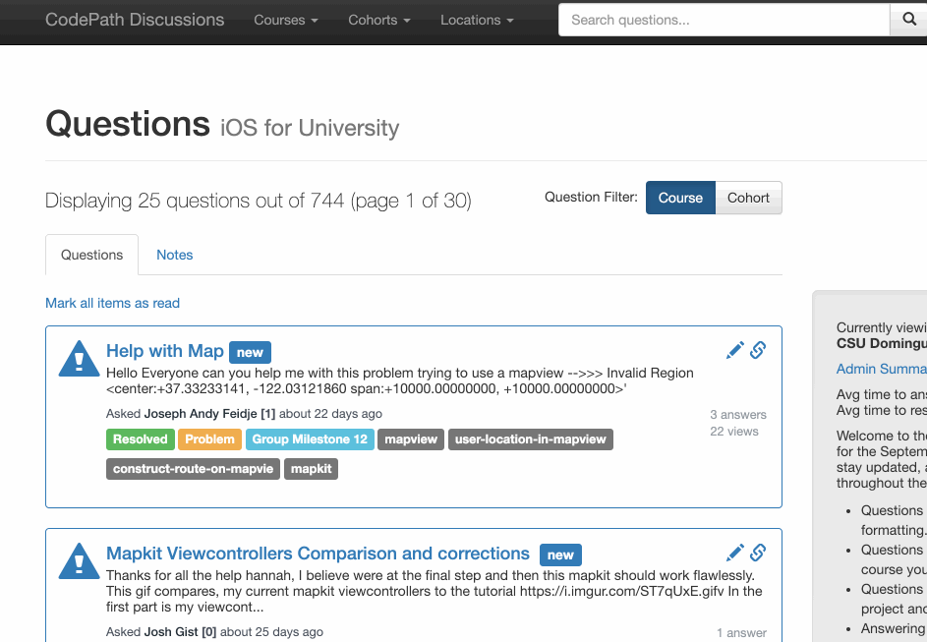
DISCUSSIONS
Notes:
Visit the Discussions Forum anytime you have a question, bug, crash, curiosity or anything else related to coursework. ☝️ Just click the link in the blue box at the top of the Course Portal.
Browse and search any question ever asked throughout all runs of this course. You can search by tag, project or keyword.
Post a question of your own, providing a description of the issue, screenshots, tags and repo link to help CodePath staff and the entire cohort network quickly get to the bottom of your problem. We'll even download and run your project ourselves to help debug if needed.
Answer questions posted by other students. Remember what we said about the importance of teaching? It's one thing to build a project and work though your own bugs, but solving someone else's issues is next level. Everyone in the cohort is encouraged to try their hand and answering questions, students, Tech Fellows and CodePath staff alike. You'll even earn a spot on our leaderboard.

Slide 26
👋 Let’s Get Aquainted
Meet your fellow developers in an
Ice Breaker Activity.
Notes:
IMPORTANT NOTES FOR NON_CREDIT SITES ONLY:
For non-credit courses, most students have likely already completed their prework. The following signup and prework sections DO NOT apply to everyone in the course, only new signups.
ASK any students who have not signed up or completed prework yet to raise there hands
If no one raises their hands, then
If there are hands raised from stu7dents who have not signed up yet and/or completed the pre-work assignment, they should be introduced to the following sign-up and prework slides.
NON-CREDIT COURSES ONLY: This is the only session for this week. The following weeks will start the normal 2 session per week cadence. Tell students you’ll see them next week!

Slide 27
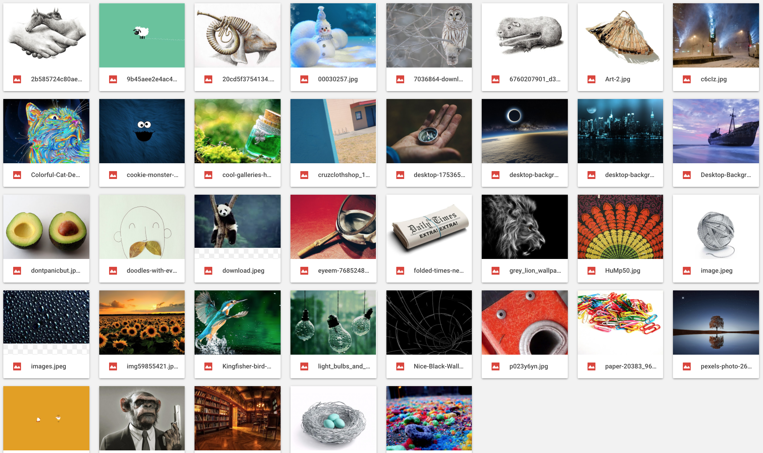
Groups Of 3: Pick two images below.
Come up with a story (movie, book, etc.) that would feature both images you picked.
Notes:
Tech Fellow should explain the activity
Have everyone into breakout groups of 3
Tell everyone they have 10 minutes
Bring everyone back
(To each group) Ask: what was the most interesting story you heard?
The point of this icebreaker is to get people to work in groups, not just think about things to themselves! They should be talking and having fun with each other.

Slide 28
📝 Signup Now!
Go to codepath.org
And signup for your course!
Notes:
IMPORTANT NOTES FOR NON_CREDIT SITES ONLY:
For non-credit courses, most students have likely already completed their prework. The following signup and prework sections DO NOT apply to everyone in the course, only new signups.
ASK any students who have not signed up or completed prework yet to raise there hands
If no one raises their hands, then
If there are hands raised from stu7dents who have not signed up yet and/or completed the pre-work assignment, they should be introduced to the following sign-up and prework slides.
NON-CREDIT COURSES ONLY: This is the only session for this week. The following weeks will start the normal 2 session per week cadence. Tell students you’ll see them next week!

Slide 29
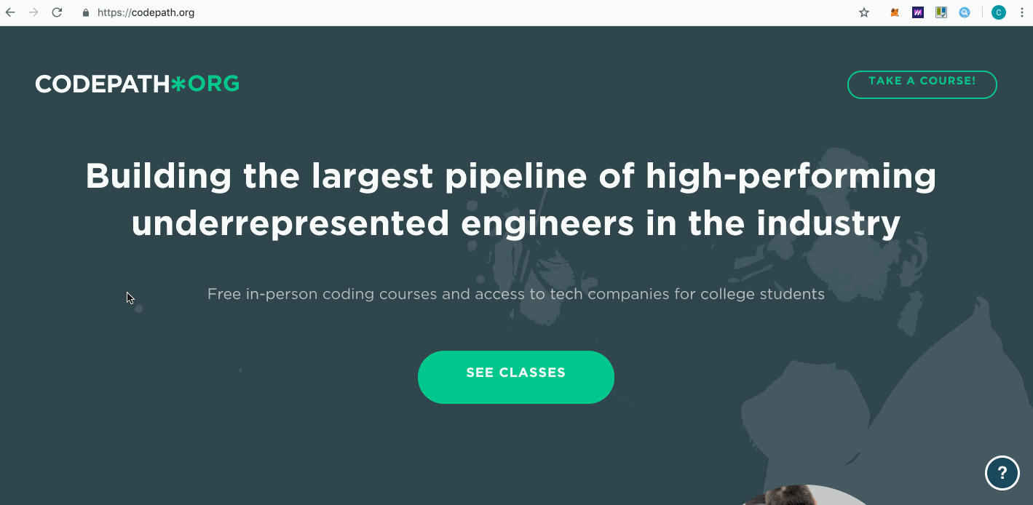
SIGN
UP
Notes:
Go to CodePath.org -> Classes -> Choose your class (iOS, Android or Cybersecurity)
Complete the application (Should take about 10min max)
NOTE: You’ll need a github account to start the application (It’s FREE!)
After you submit the application, you’ll get an email with confirming your application was received along with next steps...a prework project.

Slide 30
📳 Your First App Assignment
Let’s jump right in and
start building our first app!

Slide 31
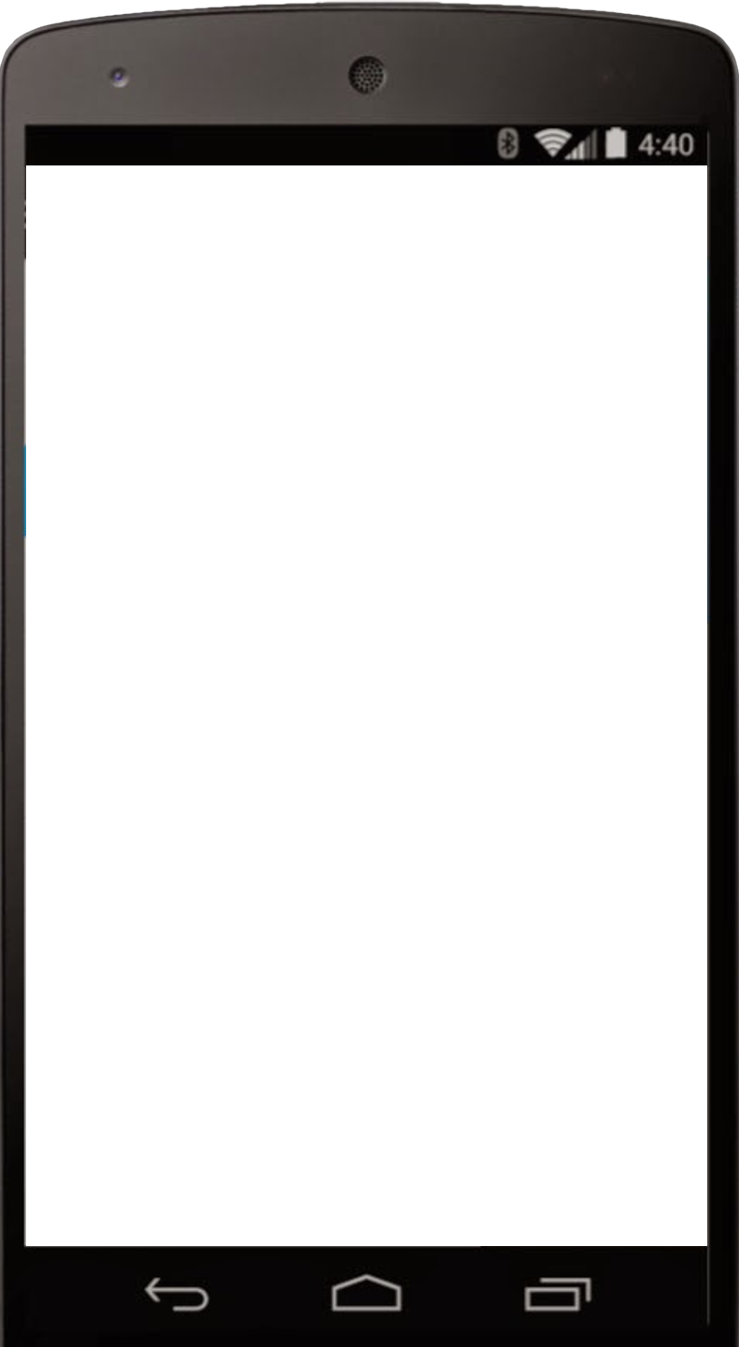
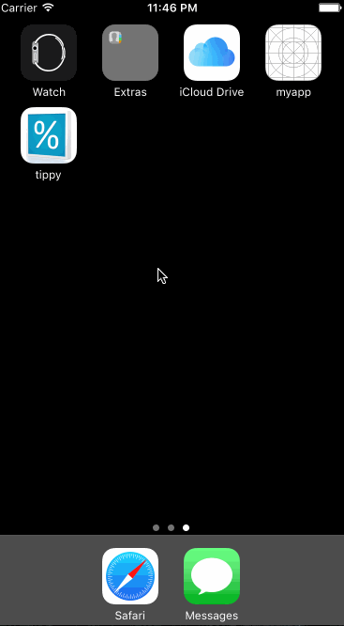
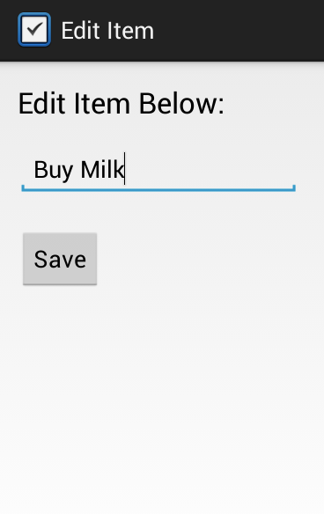
PREWORK
Tip Calculator
Tasks
iOS Courses
Android Courses
PREWORK DEADLINE
📬 Midnight before the first session of next week
Notes:
The next step is to get working on your first project whcih we refer to as prework.
Once your application is submitted, you should have received an email which includes a link to the prework
Here are the direct links to the prework instructions:
iOS: courses.codepath.com/snippets/ios_university/prework
Android: courses.codepath.com/snippets/android_university/prework
If you’re installing Xcode (iOS) or Android Studio (Android) for the first time, it’s going to take some time as it’s a 4GB or so application.
ANDROID NOTE: Students should expect to spend a decent amount of time setting up and configuring Android studio after the download is complete.
PREWORK DEADLINE: Midnight before your first clas the following week.
Submission instructions can be found on the prework instructions page (linked above)
We’ll spend the majority of the next session this week working on the prework in-class.

Slide 32
Wrap up - Any Questions? 🤔

Slide 33
See You Next Session!

Slide 34
Lets get some coding 🚀

